Slide 1
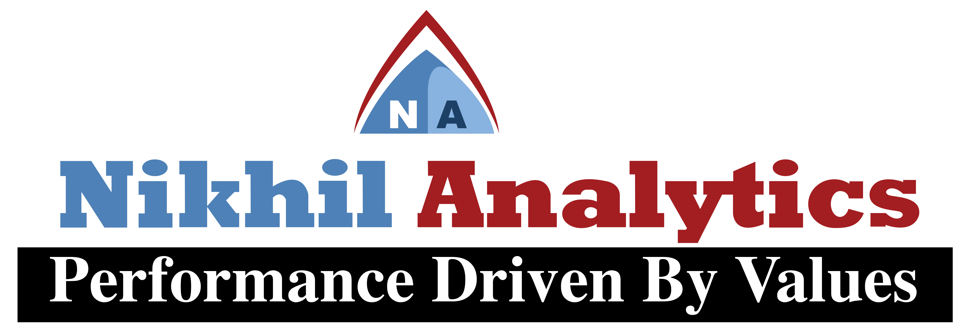
Session Vi
By
Alok Ranjan
Nikhil analytics

Slide 2
Agenda of Session Vi
Building Model
Model Validation
Linear Regression Algorithm and its Application using Python
Multiple Regression Algorithm and its Application using Python
Logistic Regression Algorithm and its Application using Python

Slide 3

Building Model
Extraction
Data cleaning
Identify x and y
Split x and y into train and test(train 70% of data and test 30% of data)
Build model using train data
Predict target for test data
Validate model using predicted value and test

Slide 4
Model Validation
Regression
Classification
R-Squared
r-squared>0.7---good fit model
r-squared>0.85--best fit model
r-squared < 0.5-poor fit model
MSE (Mean Square Error)
Confusion Matrix
Accuracy Score
Classification Report

Slide 5
LINEAR Regression Model
Regression is used to predict dependent variable using given independent Variable.
Regression is a technique for determining the statistical relationship between two or more variables where a change in a dependent variable is association with, and depends on, a change in one or more independent variables.
Y=b + wX
Where,
Y= Target X= Feature
B = bias w= Weight

Slide 6
Multiple Regression Model
Regression is used to predict dependent variable using given independent Variable.
Y=b + w1X1 + w2X2 + w3X3 + …
Where,
Y= Target X= Feature
B = bias w= Weight

Slide 7
Logistic Model
Logistic Regression is a supervised classification model.
It allows you to make predictions from labeled data, if the target (output) variable is categorical.
logit(p) =b + wX

